Slide 1
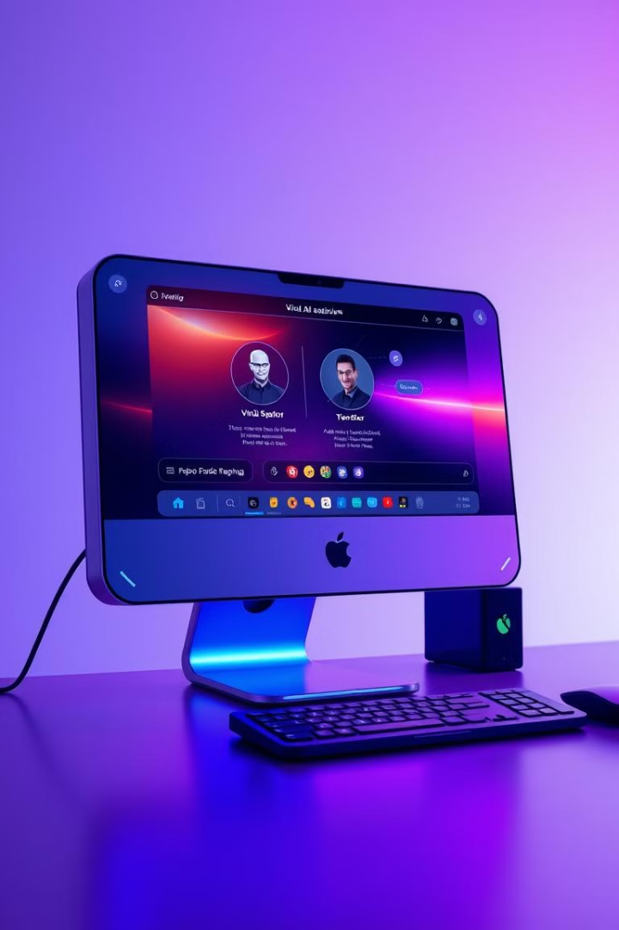
Jarvis: Desktop Assistance
Jarvis is a powerful desktop assistant that allows you to control your computer using voice commands. With its seamless integration of speech recognition, text-to-speech, and application automation, Jarvis makes your daily tasks more efficient and hands-free.

Slide 2

Introduction to Jarvis
1
Voice-Controlled Interactions
2
Multifunctional Capabilities
Jarvis understands natural language commands and responds with synthesized speech, enabling intuitive hands-free control.
Jarvis can perform a variety of tasks, from opening applications to searching the web and retrieving information.
3
Personalized Experience
Jarvis adapts to your preferences and habits, providing a tailored and seamless user experience.

Slide 3
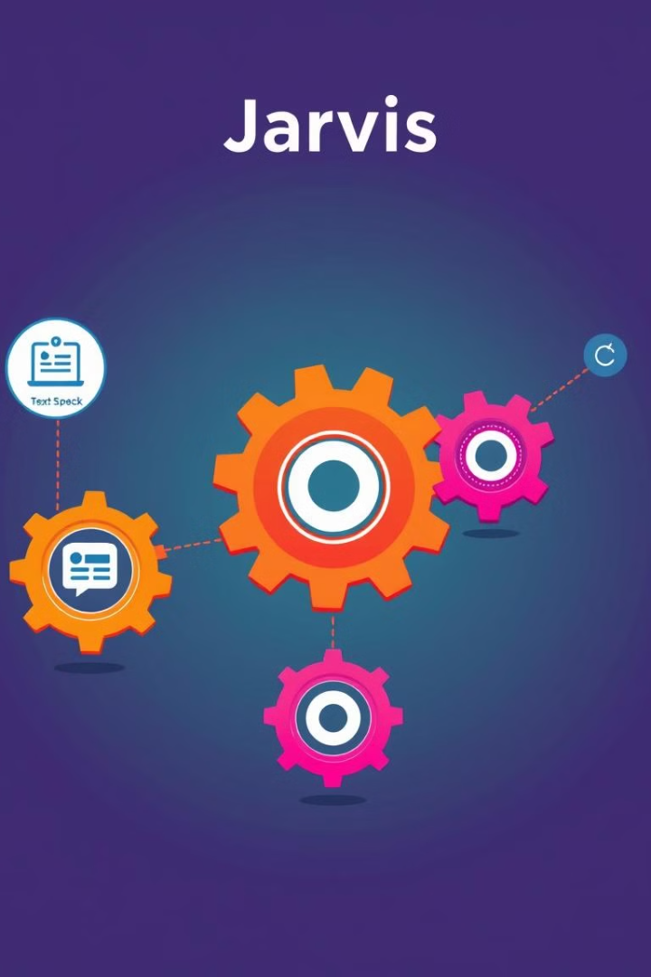
Technical Architecture
1
Input Handling
Jarvis utilizes speech recognition to convert voice commands into text for processing.
2
Command Processing
The system analyzes the user's requests and determines the appropriate actions to take.
3
Output Generation
Jarvis generates spoken responses using text-to-speech technology to provide a natural conversational interface.

Slide 4
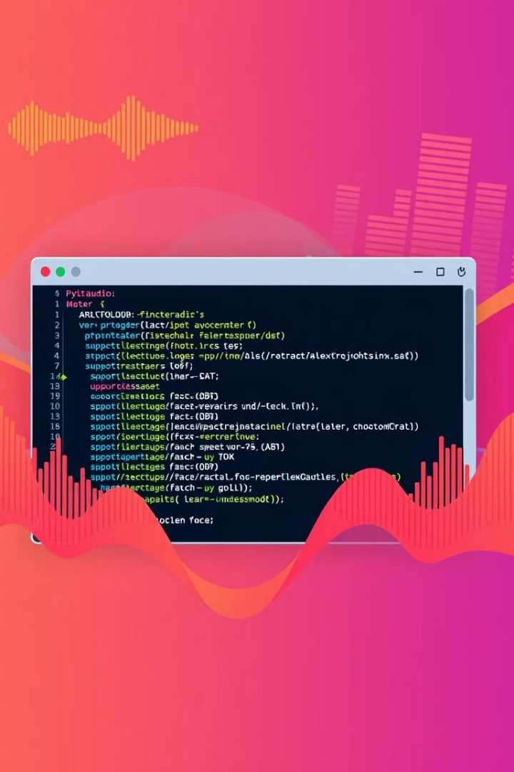
Speech Recognition Library: PyAudio
Accurate Speech-to-Text
Cross-Platform Compatibility
PyAudio provides a robust speech recognition engine that can reliably convert voice input into text commands.
The library supports a wide range of operating systems, ensuring Jarvis works seamlessly on various desktop platforms.
Low-Latency Performance
PyAudio's efficient audio processing enables Jarvis to respond to user commands in real-time with minimal lag.

Slide 5
Text-to-Speech Library: pyttsx3
Multilingual Support
Customizable Voices
Seamless Integration
pyttsx3 can generate speech in multiple languages, allowing Jarvis to communicate in a variety of dialects.
The library provides a selection of voice options, enabling users to choose a preferred tone and accent for Jarvis.
pyttsx3 seamlessly integrates with Jarvis, allowing for smooth and natural text-to-speech conversion.

Slide 6
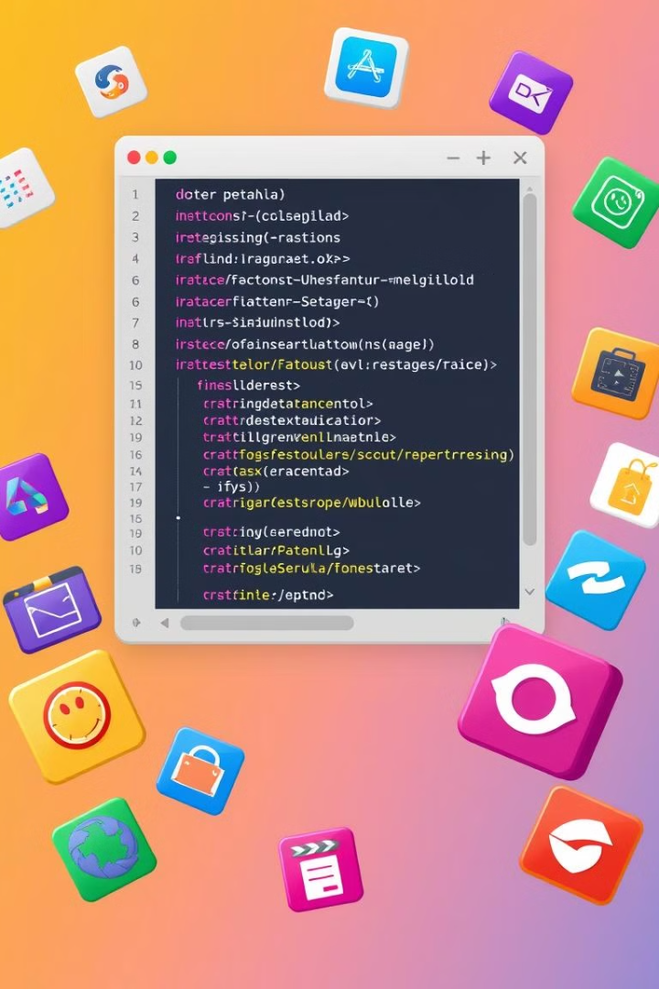



Opening Applications: os module
File Management
Application Launching
Jarvis can open files and folders using the os module's file management capabilities.
The os module allows Jarvis to launch various desktop applications based on user commands.
System Interactions
Jarvis can perform system-level tasks, such as searching for files or executing commands, using the os module.

Slide 7




Searching on Google, Wikipedia, and YouTube
Web Searches
Jarvis can perform Google searches to quickly find information on the web.
Encyclopedia Lookup
Jarvis can search Wikipedia to retrieve comprehensive information on a wide range of topics.
Video Exploration
Jarvis can search and play videos on YouTube, providing a multimedia learning experience.

Slide 8

Handling User Commands
Open Application
Launch a specific desktop application.
Web Search
Query a search engine to find information.
Wikipedia Lookup
Retrieve details from the online encyclopedia.
YouTube Playback
Search and play videos on the video platform.

Slide 9

Future Enhancements
1
Expanded Capabilities
2
AI-Powered Intelligence
Integrate additional features, such as calendar management, email integration, and smart home control.
Leverage advanced AI and machine learning techniques to enhance Jarvis's natural language understanding and task automation.
3
Multi-Modal Interactions
Expand Jarvis's input and output channels to include gesture recognition, facial expressions, and visual feedback.

Slide 10

Abhishek Kumar Tiwari - 2024464096

